Slide 1
Unsupervised Segmentation Model

Slide 2
Code and Dataset
Code
https://github.com/voxelmorph/voxelmorph/blob/dev/scripts/
Dataset https://github.com/voxelmorph/voxelmorph/tree/dev/data
(npz files)

Slide 3
Architecture
(implemented using tensorflow as well as pytorch backend)
Defined a new architecture called Voxelmorph model,VxmDense [general purpose library for learning-based tools for alignment/registration]
['https://github.com/voxelmorph/voxelmorph/blob/dev/voxelmorph/tf/networks.py']

Slide 4
Parameters:
inshape: Input shape. e.g. (192, 192, 192)
nb_unet_features: Unet convolutional features. Can be specified via a list of lists with the form [[encoder feats], [decoder feats]], or as a single integer.
If None (default), the unet features are defined by the default config described in the unet class documentation.
nb_unet_levels: Number of levels in unet. Only used when nb_unet_features is an integer. Default is None.
unet_feat_mult: Per-level feature multiplier. Only used when nb_unet_features is an integer. Default is 1.
nb_unet_conv_per_level: Number of convolutions per unet level. Default is 1.
int_steps: Number of flow integration steps. The warp is non-diffeomorphic when this
value is 0.
svf_resolution: Resolution (relative voxel size) of the predicted SVF.
Default is 1.

Slide 5
int_resolution: Resolution (relative voxel size) of the flow field during vector integration. Default is 2.
int_downsize: Deprecated - use int_resolution instead.
bidir: Enable bidirectional cost function. Default is False.
use_probs: Use probabilities in flow field. Default is False.
src_feats: Number of source image features. Default is 1.
trg_feats: Number of target image features. Default is 1.
unet_half_res: Deprecated - use svf_resolution instead.
input_model: Model to replace default input layer before concatenation. Default is None.
hyp_model: HyperMorph hypernetwork model. Default is None.
reg_field: Field to regularize in the loss. Options are 'svf' to return the
SVF predicted by the Unet, 'preintegrated' to return the SVF that's been rescaled for vector-integration (default), 'postintegrated' to return the rescaled vector-integrated field, and 'warp' to return the final, full-res warp.
name: Model name - also used as layer name prefix. Default is 'vxm_dense'.

Slide 6
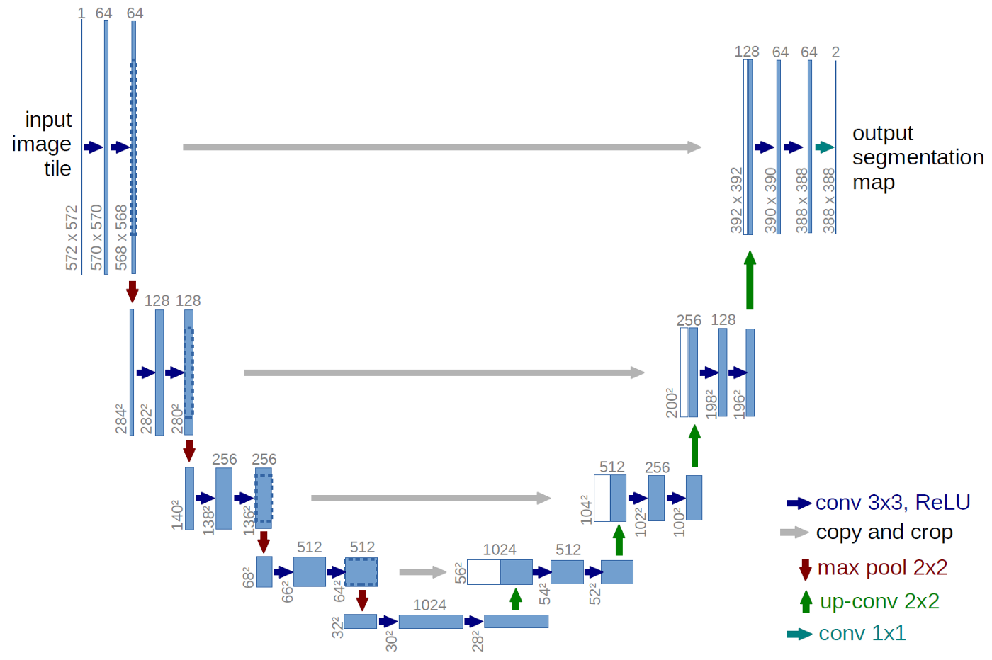
Unet
An improvement over the existing FCN — “Fully convolutional networks for semantic segmentation” Long et al. in (2014)

Slide 7
Unet architecture
UNET is a U-shaped encoder-decoder network architecture, which consists of four encoder blocks and four decoder blocks that are connected via a bridge.
Encoder network(contracting path)
Halves the spatial dimensions
Doubles the number of filters (feature channels)
at each encoder block.
Decoder network
Doubles the spatial dimensions
Halves the number of filters (feature channels)

Slide 8
Encoder network
Learns an abstract representation of the input image through a sequence of the encoder blocks.
Encoder block :
2 3x3 convolutions, each convolution is followed by a ReLU{leaky relu} activation function.
ReLU introduces non-linearity into the network → helps in the better generalization of the training data.
Output of the ReLU acts as a skip connection(shortcut connection that helps the indirect flow of gradients to the earlier layers without any degradation) for the corresponding decoder block.
2x2 max-pooling.
the spatial dimensions (height and width) of the feature maps are reduced by half.
Reduces the computational cost by decreasing the number of trainable parameters.

Slide 9
Bridge
Connects the encoder and the decoder network
Completes the flow of information.
Consists of:
2 3x3 convolutions
each convolution is followed by a ReLU activation functions

Slide 10
Decoder network
Abstract representation → a semantic segmentation mask.
The decoder block;
A 2x2 transpose convolution,
concatenated with the corresponding skip connection feature map from the encoder block.
These skip connections provide features from earlier layers that are sometimes lost due to the depth of the network.
2 3x3 convolutions are used, where each convolution is followed by a ReLU activation function.
The output of the last decoder passes through a 1x1 convolution with sigmoid activation.
The sigmoid activation function gives the segmentation mask representing the pixel-wise classification.

Slide 11
Optimizer and metrics
Optimizer:
Adam, learning rate can be defined in the command line
Metric: Dice Score

Slide 12
Results
Largely reduces the number of outliers with very poor segmentation (e.g., there are over 100 cases with
Unsupervised Deep Learning for Bayesian Brain MRI Segmentation
Dice lower than 50% in the caudate(part of the brain) for the baseline approach, and none for this method).
In the T1 dataset, the test intensity distribution is slightly different that of the training dataset. However, this approach successfully generalizes and outperforms the baseline (average 81.9% vs. 79.4%, hippocampi(part of the brain) 79.9% vs. 73.5%).
The results of the experiment with lesser data illustrates the ability of this method to adapt to contrasts other than T1, even when the data is limited, it outperforms the baseline (average 80.5% vs. 78.3%, hippocampi 76.6% vs. 69.8%).

